Slide 1
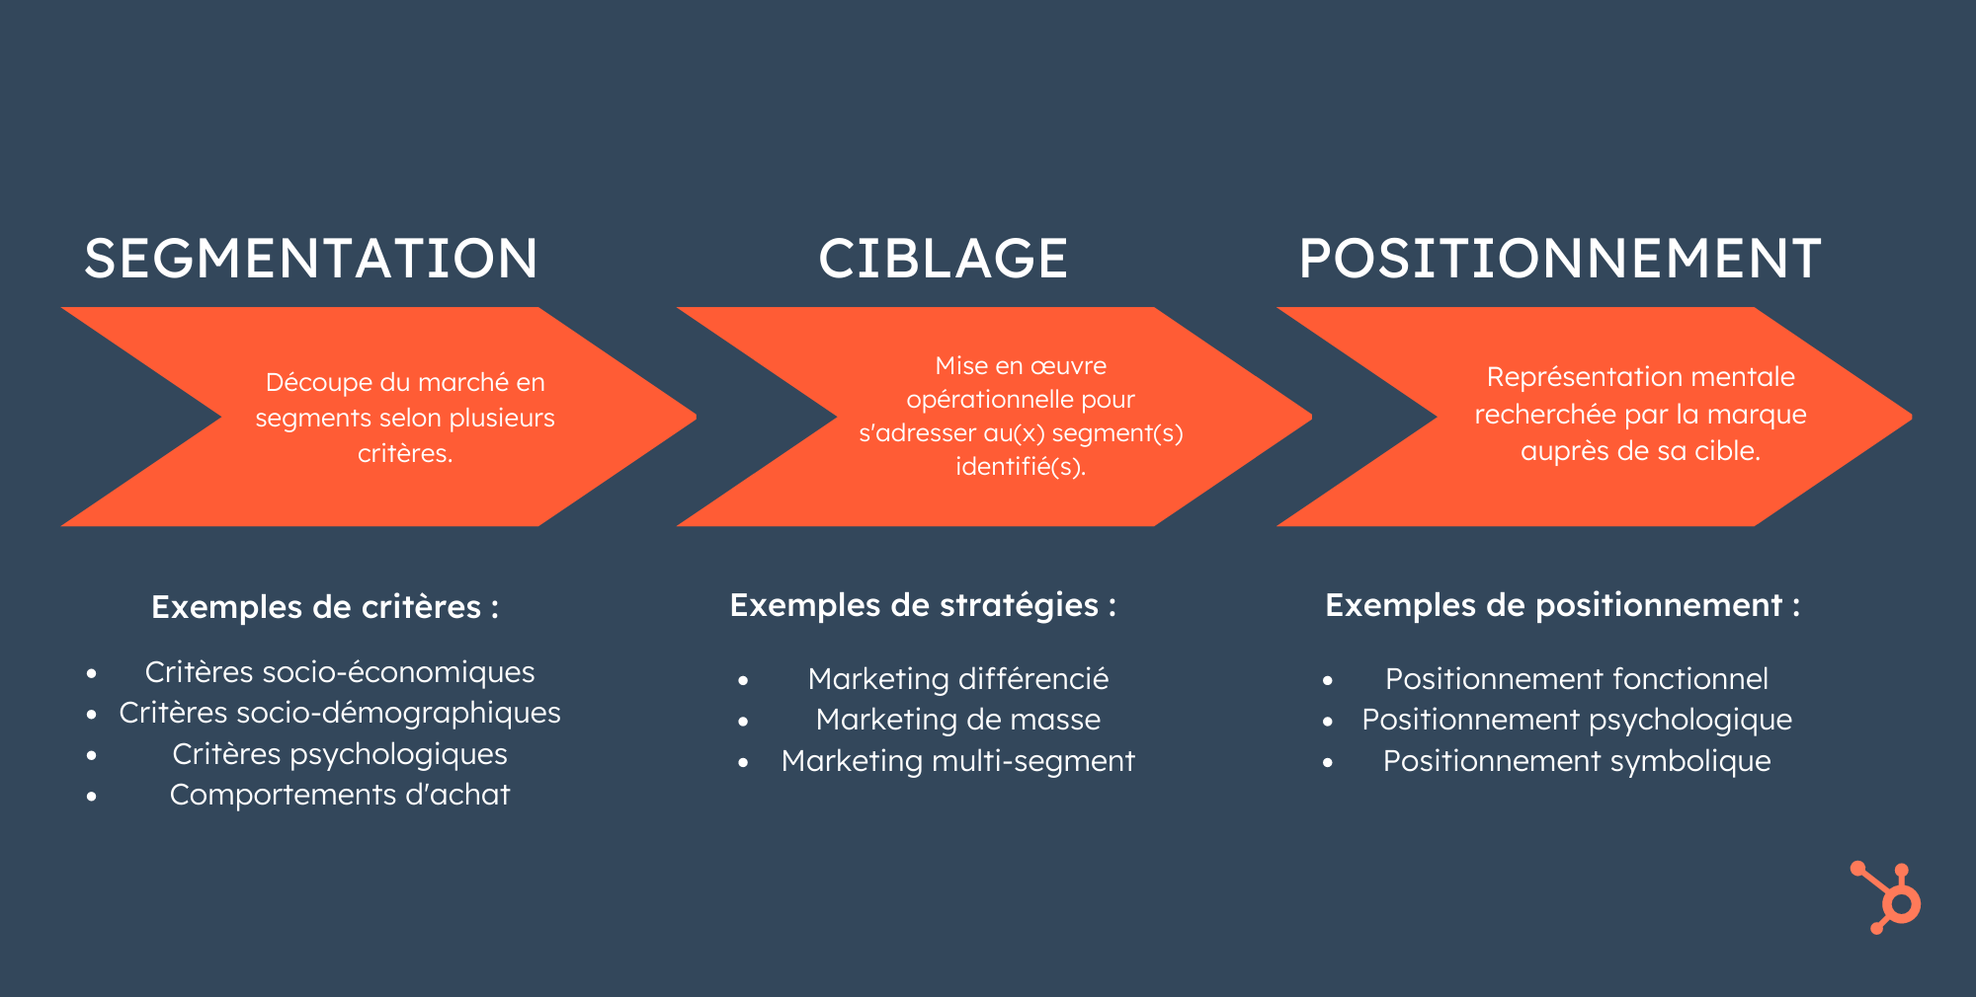

Slide 2


Slide 3
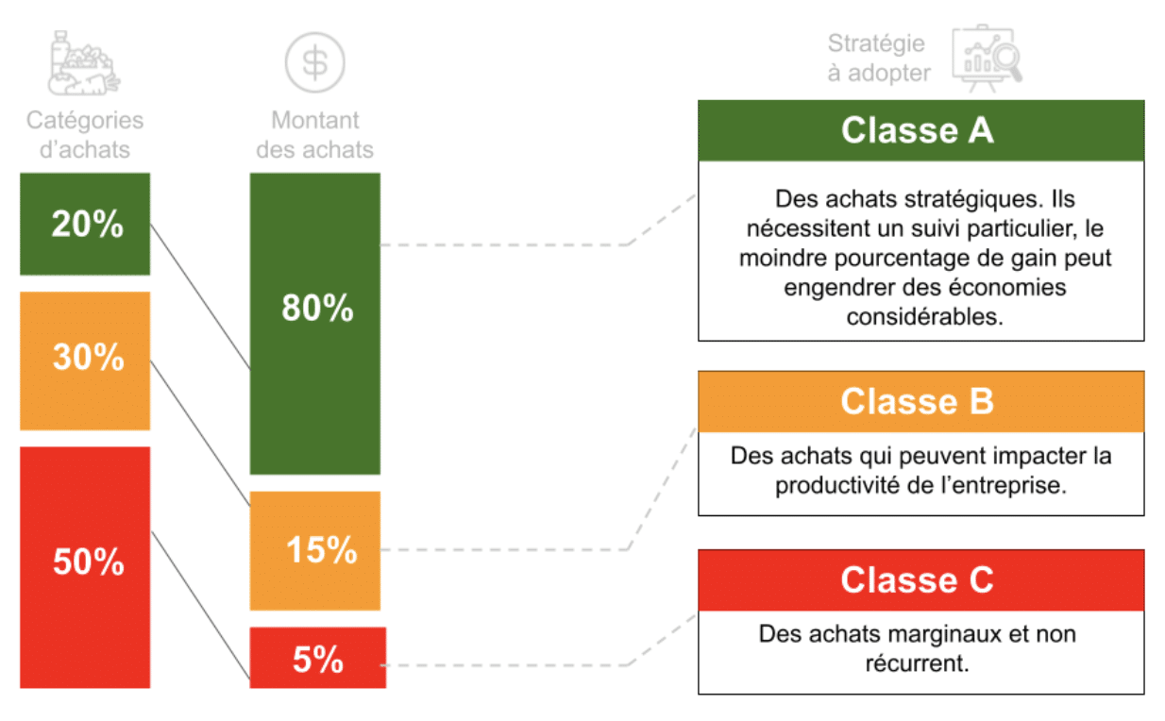
ABC

Slide 4


Slide 5
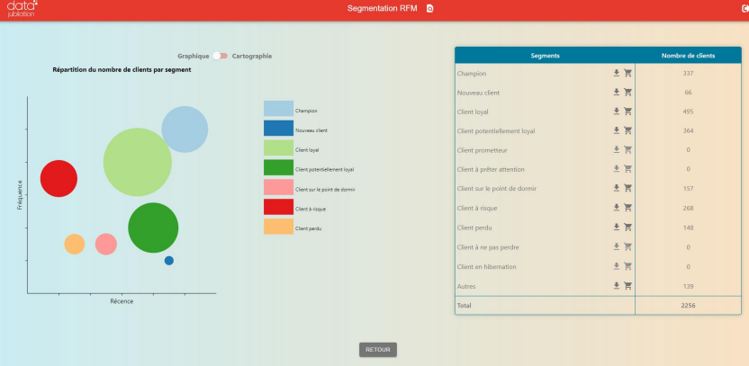

Slide 6
Exemple de critères
((r==4 or r==5) and (f==4 or f==5) and (m==4 or m==5)) -> segment = "Champion"
((r==4 or r==5) and (f==1) and (m==1)) -> segment = "Nouveau client"
((r!=1) and (f>=3) and (m>=3)) -> segment = "Client loyal"
((r>=3) and (f<=3) and (m<=3)) -> segment = "Client potentiellement loyal"
((r==3 or r==4) and (f==1) and (m==1)) -> segment = "Client prometteur"
((r==3 or r==4) and (f==3 or f ==4) and (m==3 or m==4)) -> segment = "Client a preter attention"
((r==2 or r==3) and (f==1 or f==2) and (m==1 or m==2)) -> segment = "Client sur le point de dormir"
((r<=2) and (f>=2 and f <=5) and (m>=2 and m<=5)) -> segment = "Client a risque"
((r<=2) and (f<=2) and (m<=2)) -> segment = "Client perdu"
((r==1) and (f>=4) and (m>=4)) -> segment = "Client a ne pas perdre"
((r==2 or r==3) and (f==2 or f==3) and (m==2 or m==3)) -> segment = "Client en hibernation«
-> segment="Autres"

Slide 7
